Slide 1
Resources to Use with Module
Handouts to Use with Presentation
#1A Effective Reading Comprehension Strategies
#1A Fix Up Strategies Monitoring Your Understanding
#1B Reciprocal Teaching Overview
#1B Reciprocal Teaching Primary
#1B RT Job Cards
#1C Gradual Release of Responsibility
#2A Narrative Text Structure
#2B Expository Text Structure Graphic Organizers
#2B Expository Text Structure Sort
#3B Questioning for Greater Comprehension
#3D Have Students Lead Structured Small Group
Comprehension Recommendations & Possible Solutions
Essentials in Curricular Materials
Module 5: Improving Reading Comprehension

Slide 2
Module Features
Pause Point
Handout
Video with Question/Discussion
Resource
Small Group Activity
R
Notes:
This slide is hidden. The icons on this slide are used to indicate special features in the module.

Slide 3
Moving Towards Reading on Grade Level by 3rd Grade Module 5: Reading Comprehension
ISBE ELA Content Specialists
www.ilclassroomsinaction.org
Notes:
Say: Welcome to “Moving Towards Reading on Grade Level by 3rd Grade. This is the 1st of 4 modules that will dive into the foundational skills standards.

Slide 4
Modules in the “Moving Towards Reading on Grade Level by 3rd Grade” Series
Module | Topic | Standards
Module 1 | Print Concepts | RF.1 (K-1)
Module 2 | Phonological Awareness | RF.2 (K-1)
Module 3 | Phonics and Word Recognition | RF.3 (K-5)
Module 4 | Fluency | RF.4 (K-5)
Module 5 | Reading Comprehension | Reading, Writing, Language and Speaking & Listening
Notes:
Say: This series focuses on the foundational skills of Print Concepts (Module 1), Phonological Awareness (Module 2), Phonics (Module 3) and Fluency (Module 4)
These foundational skills are necessary and important components of an effective, comprehensive reading program designed to develop proficient readers with the capacity to comprehend texts across a range of types and disciplines. Instruction should be differentiated: good readers will need much less practice with these concepts than struggling readers. The point is to teach students what they need to learn and not what they already know— to discern when particular children or activities warrant more or less attention. (CCSS)

Slide 5
Agenda
Module 5: Improving Reading Comprehension
Overview
2. Understanding the Brain
3. Recommendations #1 - #5 and Possible Solutions
4. Instruction, Materials and Time Matters
5. Assessment
6. Resources
Notes:
Say:

Slide 6
Module Outcomes
Identify the 5 recommendations that address the challenge of reading comprehension to students in Kindergarten through 3rd grade.
Identify the necessary curricular components essential for teaching reading comprehension.
Examine resources.
Notes:
Say: The module outcomes are as follows: (click to animate each outcome)
Identify the 5 recommendations that address the challenge of reading comprehension to students in Kindergarten through 3rd grade.
Identify the necessary curricular components essential for teaching reading comprehension.
Examine resources.

Slide 7
Why This Series?
The ultimate goal: 90% of students reading on grade level by 3rd grade.
Notes:
Say: This series is designed for teachers who want information on the foundational skills and how full implementation of these standards can assist our schools in 90% of our students reading on grade level by 3rd grade. What we know from research is that students who do not reach proficiency levels on the first exposures to the foundations of reading will need MORE exposures and experiences. Otherwise, they risk becoming the students who are reading five (or more) years below grade level in high school – the ones who rarely graduate. (Hernandez, 2001)
Hernandez, D. (2011, April). Double jeopardy: How third-grade reading skills and poverty influence high school graduation. Baltimore: The Annie E. Casey Foundation, p. 3.

Slide 8
Why It Matters
Notes:
Say: Research concludes that we can catch poor readers before they fall. Robert Slavin’s work at John Hopkins University states “Recent studies conclude that 85% to 90% of even our poorest readers can be taught to read at grade level.“
Additional Information:
At the National Institute of Child Health and Human Development, the director states “We have learned that for 90% to 95% of poor readers, prevention and early intervention programs...can increase reading skills to average reading levels. We have also learned that if we delay intervention until nine years of age, approximately 75% of the children will continue to have difficulties learning to read throughout high school.” Robert Slavin, Johns Hopkins University

Slide 9
Factors in Building Reading Ability
Parents who serve as their children’s first teachers;
Access to high-quality preschool;
Kindergarten programs that help children catch up if they missed out on preschool; and
Skilled instruction in the first through third grades.
Notes:
Say: Learning to read is a complex matter that begins long before a child starts school. In fact, researchers now know that the foundation for reading lies in the oral language children are exposed to and develop in the first three years of life (Hart & Risley, 1995). Researcher Judith Carroll sets out a “road map” for developing grade-level reading, beginning with the first words babies hear and speak. Carroll lists four factors in building reading ability. (Click to animate) While all factors are important, educators only have control over the last two factors.

Slide 10
Four Foundational Skills Standards
ELA Standards: K-5
Print Concepts (RF.1) K &1
Phonological Awareness (RF.2) K & 1
Phonics and Word Recognition (RF.3) K,1,2,3,4 & 5
Fluency (RF.4) K,1,2,3,4 & 5
Reading Comprehension (RI, RL, SL, L, & W) K-5
Notes:
Say:

Slide 11
Offering Students Strong Roots
Comprehension
Strong Reader
Print Concepts
Fluency
Phonological Awareness
Phonics
Notes:
Say: The foundational Skills offer students “strong roots” in becoming a grade level reader. The strong roots offer students a strong foundation in reading. Strong readers continue to grow as a reader even when text gets tough. - Module 1-4 focuses on the foundational skills: Print Concepts Phonological Awareness, Phonics & Word Recognition and Fluency. Research tells us that a safe learning environment is necessary for a students to grow strong roots as well.
If all of those components have been taught and “caught” by our students then they will continue to grow as readers by comprehending (click) what they are reading. (click)

Slide 12
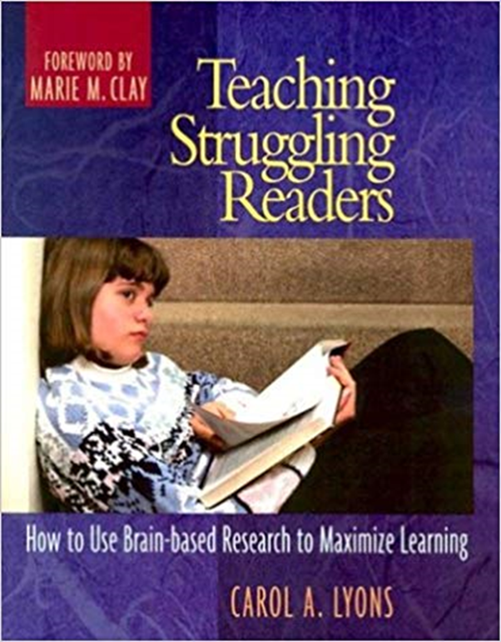
Understanding the Brain and the Impact on Instruction
Notes:
Say: Providing a safe learning environment is critical for students to learn. Let’s take a look at what research says about the brain. (Pass out the handout “Understanding the Brain”)
Click – Let’s pause and read through what research tells us about the brain and student learning.
Have participants note the piece of research that they find the most impactful for schools or to their own teaching. Have participants share out.
(A number of factors should be mentioned in discussion – for example, early help, nonthreatening, supportive environments, high expectations)

Slide 13
Skills & Knowledge Critical to Comprehension
Word-level skills
Vocabulary knowledge and oral language skills
Broad conceptual knowledge
Knowledge and abilities required specifically to comprehend text
Thinking and reasoning skills
Motivation to understand and work toward academic goals
Notes:
Say: The current research on reading indicates that the following types of skills and knowledge are critical to building a young student’s capacity to comprehend what he or she reads:
(click to animate and read the following)
Word-level skills allow students to identify, or decode, words in text accurately and fluently. Instruction in this area includes phonemic awareness, word analysis strategies (especially phonemic decoding), sight word vocabulary, and practice to increase fluency while reading.
Vocabulary knowledge and oral language skills help readers understand the meaning of words and connected text. Instruction in this area involves strategies to build vocabulary and activities to strengthen listening comprehension.
Broad conceptual knowledge includes not only general knowledge of the world but also knowledge drawn from science, social studies, and other disciplines. An information-rich curriculum can help students develop the background that is necessary for good reading comprehension.¹⁰
Knowledge and abilities required specifically to comprehend text include an understanding of the different ways text can be structured and the ability to use a repertoire of cognitive strategies.
Thinking and reasoning skills that are involved, for example, in making inferences are essential to reading comprehension as text becomes more complex and as a student’s tasks depend more on the thoughtful analysis of content.
Motivation to understand and work toward academic goals makes it more likely that students will intentionally apply strategies to improve their reading comprehension. Comprehending complex text requires active mental effort, which is most likely to occur when a student is engaged in the task at hand.

Slide 14
Reading Comprehension Defined
Notes:
Say: We will begin this module with a definition of reading comprehension.(Have participants find the definitions in the guidance document)

Slide 15
Reading Comprehension
“Reading Comprehension is the process of simultaneously extracting and constructing meaning through interaction and involvement with written language.”
Extracting meaning: understand what an author has stated whether explicitly or implicitly.
Constructing meaning is to interpret what an author has said by bringing one’s capabilities, abilities, knowledge and experiences to bear on what he or she is reading.
Improving Reading Comprehension in Kindergarten Through 3rd Grade Practice Guide
Notes:
Say: Reading Comprehension is the process of simultaneously extracting and constructing meaning through interaction and involvement with writing language. Extracting meaning is to understand what an author has stated, explicitly or implicitly. Constructing meaning is to interpret what an author has said by bringing one’s “capabilities, abilities, knowledge, and experiences” to bear on what he or she is reading.
These personal characteristics also may affect the comprehension process.

Slide 16
Listening Comprehension
Notes:
Although listening comprehension remains a strong predictor of reading comprehension after 1st grade, most students can read words independently from the 2nd grade onward. Therefore, the panel judged the evidence for 2nd- and 3rd-grade students on the basis of outcome measures for reading comprehension only, and for kindergarteners and 1st-grade students on the basis of outcome measures for listening comprehension when reading comprehension outcomes were not available.

Slide 17
Where Do We Start?
Notes:
Say: As children enter our doors at the beginning of the school year, we need to find where students are with reading comprehension. Our materials should have a number of assessments at our disposal. Additional assessment information will come later in this module.

Slide 18
Research for Module 5
Improving Reading Comprehension in Kindergarten Through 3rd Grade
One of the Institute of Education Sciences’ (IES) What Works Clearinghouse (WWC) Practice Guides
5 Recommendations based on research
https://ies.ed.gov/ncee/wwc/Docs/PracticeGuide/readingcomp_pg_092810.pdf
For additional information, check out the companion piece
Foundational Skills to Support Reading for Understanding in Kindergarten Through 3rd Grade
https://ies.ed.gov/ncee/wwc/Docs/PracticeGuide/wwc_foundationalreading_040717.pdf
Notes:
Say: This module is based on the research from the he Institute of Education Sciences (IES) which publishes practice guides in education to bring the best available evidence and expertise to bear on current challenges in education. Authors of practice guides combine their expertise with the findings of rigorous research, when available, to develop specific recommendations for addressing these challenges. The authors rate the strength of the research evidence supporting each of their recommendations. The authors of this practice guide are
Timothy Shanahan (Chair)- University of Illinois at Chicago, Kim Callison-Anne Arundel Public Schools, Christine Carriere - Chicago Public Schools, Nell K. Duke - Michigan State University,
P. David Pearson - University of California–Berkeley, Christopher Schatschneider - Florida State University and Florida Center for Reading Research, and Joseph Torgesen - Florida State University and Florida Center for Reading Research.
(Click) Reading requires a rich and complex array of abilities that enable comprehension, not all of which are specifically reading comprehension skills. For example, successful decoding undergirds successful reading comprehension, and it certainly should be taught, but the panel believes decoding instruction alone will not produce desired levels of reading comprehension for all students. The current research on reading indicates that the following types of skills and knowledge are critical to building a young student’s capacity to comprehend what he or she reads:

Slide 19
Important Note
The examples presented from the evidence guide are not, however to be construed as either the only or the most effective ways to put each recommendation into practice. They are intended to illustrate practices that have been used successfully to teach reading comprehension.
Notes:
(Read slide)
Say:
Strong reading comprehension skills are central not only to academic and professional success, but also to a productive social and civic life. These skills build the capacity to learn independently, to absorb information on a variety of topics, to enjoy reading, and to experience literature more deeply.

Slide 20
What Does Reading Require?
Word level skills
Vocabulary knowledge and oral language skills
Broad conceptual knowledge
Knowledge and abilities required specifically to comprehend text
Thinking and reasoning skills
Motivation to understand and work toward academic goals
Notes:
Say: Reading requires a rich and complex array of abilities that enable comprehension, not all of which are specifically reading comprehension skills. For example, successful decoding undergirds successful reading comprehension, and it certainly should be taught, but the panel believes decoding instruction alone will not produce desired levels of reading comprehension for all students. The current research on reading indicates that the following types of skills and knowledge are critical to building a young student’s capacity to comprehend what he or she reads:
1. Word-level skills allow students to identify, or decode, words in text accurately and fluently. Instruction in this area includes phonemic awareness, word analysis strategies (especially phonemic decoding), sight word vocabulary, and practice to increase fluency while reading.
2. Vocabulary knowledge and oral language skills help readers understand the meaning of words and connected text. Instruction in this area involves strategies to build vocabulary and activities to strengthen listening comprehension.
3. Broad conceptual knowledge includes not only general knowledge of the world but also knowledge drawn from science, social studies, and other disciplines. An information-rich curriculum can help students develop the background that is necessary for good reading comprehension.¹⁰
4. Knowledge and abilities required specifically to comprehend text include an understanding of the different ways text can be structured and the ability to use a repertoire of cognitive strategies.
Thinking and reasoning skills that are involved, for example, in making inferences are essential to reading comprehension as text becomes more complex and as a student’s tasks depend more on the thoughtful analysis of content.
6. Motivation to understand and work toward academic goals makes it more likely that students will intentionally apply strategies to improve their reading comprehension. Comprehending complex text requires active mental effort, which is most likely to occur when a student is engaged in the task at hand.
(click) Acknowledging the plethora of instructional demands that teachers must address in the early primary grades, this guide focuses on the last three areas, which represent explicit instruction in reading comprehension. The panel believes that these should be taught and fostered, along with the first three, right from the start rather than waiting until the word-level skills are firmly established. This belief is encouraged by research suggesting that proficiency in reading comprehension depends on the ability to bring the skills in all six areas to bear on the reading process itself

Slide 21
To Be Successful…
The 5 recommendations must be implemented in concert and clearly explained in a rich educational context that includes:
A comprehensive literacy curriculum
Ample opportunity for students to read and write while being coached and monitored by teachers
Additional instruction and practice for students based on the results of formal and informal assessments
Adequate resources for students and teachers
Notes:
Say: To be successful, these five recommendations must be implemented in concert, and clearly explained in a rich educational context that includes
(Click) A comprehensive literacy curriculum
(Click) Ample opportunity for students to read and write while being coached and monitored by teachers
(Click) Additional instruction and practice for students based on the results of formal and informal assessments
(Click) Adequate resources for students and teachers

Slide 22
When Do We Teach Comprehension Skills?
.
Notes:
Say: The teaching of reading comprehension should begin in kindergarten and elementary school. Instructional practices in Kindergarten or early 1st grade, when students are beginning to read, can and will differ from practices in 2nd or 3rd grade, when students exhibit more mastery over language.
Consequently, the recommendations may need to be adapted to students of different ages or at different reading levels

Slide 23
Improving Reading Comprehension Guide
Recommendation #1
Practices
Recommendation #2
Practices
Recommendation #3
Practices
Recommendation #4
Practices
Recommendation #5
Practices
Notes:
Say: (Click while saying…) Each recommendation will be accompanied by instructional practices that can be used in the classroom. (Provide the handout titled “Module 5: Improving Reading Comprehension”.)

Slide 24
Recommendation #1 A
#1: Teach students how to use reading comprehension strategies:
Teach students how to use several research-based reading comprehension strategies.
Teaching reading comprehension strategies individually or in combination.
Teaching reading comprehension strategies by using a gradual release of responsibility.
Notes:
Say: The first recommendation is “Teach students how to use reading comprehension strategies. Let’s begin with recommendation #1A. Good readers use many forms of thinking and analyzing text as they read. It is therefore important to teach beginning readers strategies for constructing meaning from text.

Slide 25
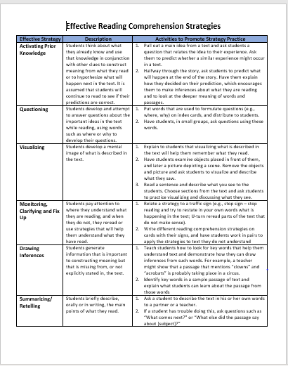
#1A: Optional Resource
Description
Possible Activities
Strategy
Notes:
(A handout is provided that lists some strategies that may benefit students in reading comprehension titled Effective Reading Comprehension Strategies)
Say: The strategies listed can improve comprehension when taught individually or in combination with other effective comprehension strategies. Two of the studies listed in the evidence guide found that students who struggle to understand what they read, teaching multiple comprehension strategies and instructing them to choose among the ones they know improves their reading comprehension.

Slide 26
Recommendation #1 B
#1: Teach students how to use reading comprehension strategies:
Teach students how to use several research-based reading comprehension strategies.
Teach reading comprehension strategies individually or in combination.
Teach reading comprehension strategies by using a gradual release of responsibility.
Notes:
Say: In addition, readers may benefit from being taught strategies individually or in combination.

Slide 27
#1B: Optional Strategy
Reciprocal Teaching in the Primary Grades
https://notafraidtolearn.wordpress.com/reading-comprehension-reciprocal-teaching/
Notes:
Say: For example, Reciprocal Teaching is one strategy that combines the instructional practices teaching comprehension strategies in combination and with the gradual release of responsibility.
Reciprocal teaching refers to an instructional activity in which students become the teacher in small group reading sessions. Teachers model, then help students learn to guide group discussions using four strategies: summarizing, question generating, clarifying, and predicting. Once students have learned the strategies, they take turns assuming the role of teacher in leading a dialogue about what has been read.
The website listed on the slide offers additional information about Reciprocal Teaching.

Slide 28
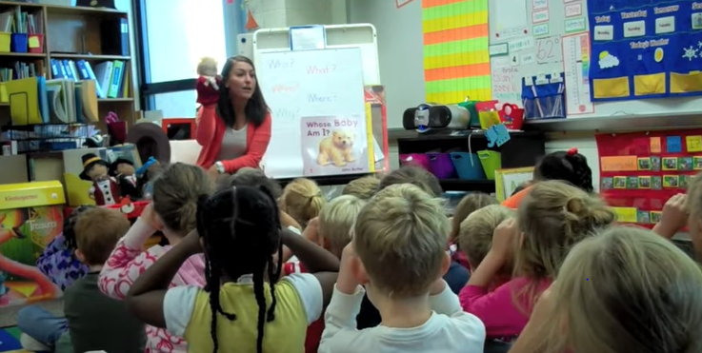
Reciprocal Teaching Strategy in Action
Reciprocal Teaching in Kindergarten
https://www.youtube.com/watch?v=Jm4mSVXDCjE
Notes:
Say: Let’s take a look at how a Kindergarten teacher employs this strategy using the fab four friends. (7 min. 57 sec). If time allows, discuss the video and how ideas could be implemented.

Slide 29
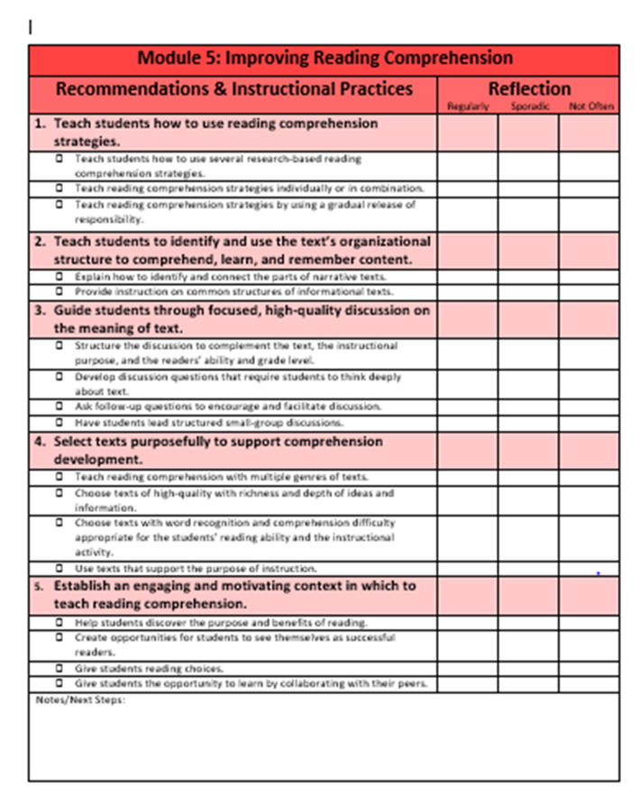
#1B: Optional Strategy – Reciprocal Teaching
#1
#3
#5
Notes:
Say: When I look at the recommendations and instructional practices on the handout Module 5: Improving Reading Comprehension , I notice that reciprocal teaching for primary grades includes practices that are listed for recommendation #1 (click), but also parts of recommendation #3 (click) and #5 (click).

Slide 30
Recommendation #1 C
#1: Teach students how to use reading comprehension strategies:
Teach students how to use several research-based reading comprehension strategies.
Teach reading comprehension strategies individually or in combination.
Teach reading comprehension strategies by using a gradual release of responsibility.
Notes:
(click) Say: Now let’s look at another key component of teaching students comprehension strategies. The gradual release or responsibility.

Slide 31
Notes:
Say: Sometimes students who may struggle do very little work in the classroom. If we do all the heavy lifting for students in reading complex texts, they begin to lean on that support rather than learn from it. Providing students strategies and time to build stamina is imperative.

Slide 32
#1c: Gradual Release of Responsibility
Notes:
(Use handout titled Gradual Release of Responsibility with this slide).
Say: Because the use of strategies may not come naturally to many young readers, strategies should be taught through a gradual release of responsibility, in which the teacher first explains how to use the strategy and then gives students more and more independence in practicing and applying the strategy over time. The table on the slide demonstrates this shift in responsibility from teacher to student. Effective instruction in reading comprehension strategies often includes some or all of the steps in this model.
While going through the steps with the class, a teacher should periodically review the purpose of any given strategy and how it improves comprehension until students can apply it independently while they read. Cycle back through the gradual release process as the text/topics/concepts become more difficult.

Slide 33
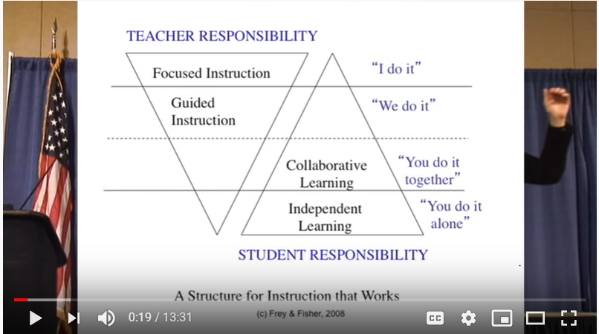
A Structure for Instruction
https://www.youtube.com/watch?v=cjURdvzty4c
Notes:
Say: In this video, Doug Fisher describes the aspects or components of gradual release of responsibility. (13 min. & 31 sec) Emphasize that when using the gradual release model that teachers DON’T always use it in order. (Feel free to abbreviate the video to meet time constraints.)

Slide 34
Gradual Release of Responsibility: Key Reminders
Notes:
Say: Remind students to use not only the strategy they just learned but also others they already know, and offer tips on when to use the strategies. Talk with students about the value of using strategies to understand what they read so that they understand that strategies are important to both the assignment at hand and to reading in general.

Slide 35
3 Potential Roadblocks for Recommendation #1
Roadblock 1: How will teachers know whether their implementation of a multiple-strategy approach is correct?
Roadblock 2: Your reading assessment may emphasize comprehension skills (e.g., main idea, drawing conclusions), not strategies.
Roadblock 3: Students bring to the classroom a wide variety of abilities in reading and reading comprehension, so adapting strategy instruction to an individual student can be a challenge.
Notes:
Say: There are 3 potential roadblocks for recommendation #1 as mentioned in the evidence guide.
(click)
Roadblock 1: How will teachers know whether their implementation of a multiple-strategy approach is correct?
(click)
Roadblock 2: Our reading assessment emphasizes comprehension skills (e.g., main idea, drawing conclusions), not strategies.
(click)
Roadblock 3: Students bring to the classroom a wide variety of abilities in reading and reading comprehension, so adapting strategy instruction to an individual student can be a challenge.

Slide 36
3 Possible Roadblock Solutions
More professional learning that involves examples and feedback may be necessary for multiple strategy approaches.
Keep in mind that the purpose of teaching reading comprehension strategies is to teach students how to think when they are reading, which in itself will improve their ability to perform well on reading assessments as well as learn other skills.
Small groups should be formed to provide targeted assistance to students offering them modeling, guided practice and feedback.
Notes:
(Pass out Comprehension Recommendations and Possible Solutions handout – participants should follow the directions and mark any possible solution that may work for their school/classroom for this recommendation).
(Participants should follow the directions for the handout Comprehension Recommendations and Possible Solutions and mark any possible solution that may work for their school/classroom for this recommendation).
Say: There are 3 possible roadblock solutions mentioned in the guide.
Roadblock 1: A multiple-strategy approach is more elaborate than a single-strategy approach. How will teachers know whether their implementation is correct?
Suggested Approach. A multiple-strategy approach may require more professional development than a single-strategy approach. Teachers should have an opportunity to see examples of successful multiple-strategy instruction and to try it out with feedback from knowledgeable professionals, including other teachers and coaches with experience using the format. Guides that show teachers how to implement specific multiple-strategy formats in the classroom (such as professional books, manuals, and videos) may also be purchased.
Roadblock 2: The school reading assessment emphasizes comprehension skills (e.g., main idea, drawing conclusions), not strategies.
Suggested Approach. Although there is nothing wrong with instruction that emphasizes certain types of questions or information in a text, the purpose of teaching reading comprehension strategies is to teach students how to think when they are reading, which in itself will improve their ability to perform well on reading assessments. The panel believes that it is critical for teachers to focus on the strategies described in this recommendation, and that these strategies may help students learn other skills outlined in our standards.
Roadblock 3: Students bring to the classroom a wide variety of abilities in reading and reading comprehension, so adapting strategy instruction to an individual student is a challenge.
Suggested Approach. Teachers should form small groups of students with similar comprehension needs or skills, allowing them to focus targeted help on a few students at a time. For instance, instead of releasing responsibility to all students at once, teachers may want to model a strategy more than once for some students, or lengthen the periods of guided practice while giving feedback to students who are struggling to practice on their own. Breaking down the lesson into smaller sections or reading a smaller section of a text together also can help students who are having trouble comprehending a particular

Slide 37
Recommendation #2 A
#2: Teach students to identify and use the text’s organizational structure to comprehend, learn, and remember content.
Explain how to identify and connect the parts of narrative texts.
Provide instruction on common structures of informational texts.
Notes:
Say: The panel believes that students comprehend and remember content better when they are taught to recognize the structure of a text because it can help them to extract and construct meaning while reading. For instance, understanding how stories are organized helps students to distinguish between major and minor events and predict how a story might unfold.
The panel believes teachers should teach students to recognize text structure by gradually releasing responsibility while keeping the goal of independent reading in mind. The idea is to prepare students to draw on what they know about structure to help them understand more complex texts.
(click) Let’s look at the first at narrative text structure.

Slide 38
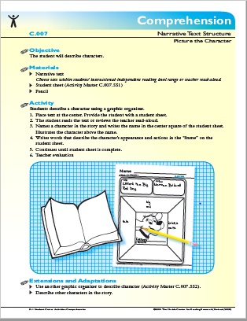
#2A: Explain how to identify and connect the parts of narrative texts.
Notes:
Say: Teachers can use their core reading programs to teach students about narrative structures, because these materials traditionally include narrative texts. Class discussions of recently read books should include questions about key elements of the text’s structure.
The structure first be taught through stories that are familiar to students, such as Goldilocks and the Three Bears or Little Red Riding Hood. (Keep in mind that some students from various cultural backgrounds may not be familiar with certain folktales like this one.)
Handout: The 24 page handout from FCRR (Florida Center for Reading Research) offers teachers a number of graphic organizers and ideas that can be made into literacy centers or used in individual, small and/or whole group instruction to teach narrative text structure.

Slide 39
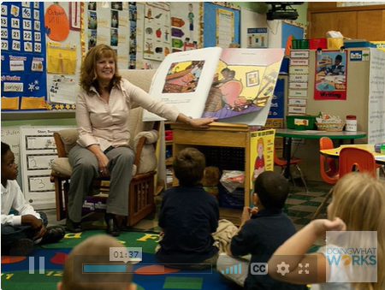
#2A: Strategy in Action
https://raisingthebar.wested.org/resource/teaching-character-and-setting-inclusion-classroom
Notes:
Say: Let’s watch how a kindergarten teacher adapts a lesson on narrative text elements for her special needs students. Instructional strategies include building on background knowledge, using visual materials, character and setting illustrations, and reteaching. Review the related sample materials.
Note: If the audience is mostly older grades of 2nd or 3rd the video on the next slide is for 3rd grade. Use either or both videos.
Additional Information:
This link (https://raisingthebar.wested.org/resource/uncovering-text-structure) has Joanna Williams discuss the importance of teaching children about narrative and informational text structure and describes some instructional tools she has used in her research with teachers. It is 5 min & 45 sec long)

Slide 40
#2A: Strategy in Action
https://raisingthebar.wested.org/resource/gertrude-took-nose-dive
Notes:
Say: Let’s watch a third-grade teacher demonstrate how to teach narrative text elements using a graphic organizer. The teacher incorporates several strategies throughout the lesson, such as modeling, questioning, picture clues, predicting, and partner work. (this is a 6 min video)
Additional Information:
This link (https://raisingthebar.wested.org/resource/uncovering-text-structure) has Joanna Williams discuss the importance of teaching children about narrative and informational text structure and describes some instructional tools she has used in her research with teachers. It is 5 min & 45 sec long)

Slide 41
Recommendation #2 B
#2: Teach students to identify and use the text’s organizational structure to comprehend, learn, and remember content.
Explain how to identify and connect the parts of narrative texts.
Provide instruction on common structures of informational texts.
Notes:
Say: Let’s examine text structures of informational text, a more challenging task, since the structures can vary from text to text and even vary within a text.

Slide 42
#2B: Provide instruction on common structures of informational texts.
Text Structure
Description
Sequence
Problem & Solution
Cause & Effect
Compare & Contrast
Notes:
Say: There are at least 5 types of informational text structures. Informational text structures typically apply to paragraphs or passages, and the entire text may contain multiple structures. Teachers should use familiar ideas or topics when teaching students about the structure of informational text, and initially use texts that provide clear, easy-to-recognize examples of the structure. A handout is provided that lays out the different structures. (pass out handout) from FCRR titled Expository Text Structure.
For example:
Let’s look at Compare and contrast.

Slide 43
#2B: Optional Lesson Idea
Notes:
Say: A teacher could share a compare and contrast text on different types of pets or on two or three modes of transportation and have the students work collaboratively to create a table or Venn diagram detailing the similarities and differences. The teacher can use this example to explain that some texts explore how certain things are similar or different. Students can then work with other texts to decide whether they show how two or more things are the same or different, discuss how they determined this, and create similar tables for those that do.
A teacher should then ask students to identify clue words in a passage—such as alike, unlike, both, but, however, than—that signal the use of a certain structure: in this case, compare and contrast. (Teachers should instruct students not to rely solely on the clue words to identify the structure because those words may not always be used.) Following the earlier example, the students can use a familiar text to locate a given clue word and figure out whether it signals a similarity or difference. The students can then use these words to help them sort the facts in an unfamiliar compare and contrast text and create a table. Use a similar process to introduce students to the other common informational text structures.
Students can organize information from expository texts by using graphic tools (e.g., concept maps, Venn diagrams, fishbone charts, and sequence diagrams or flow charts).
Once students can comfortably identify the structure of a passage and recall its content, a teacher can replace leading questions (“What was the cause? What was the effect?”) with more complex questions that do not include clue words,⁶³ such as “How did the author organize the information in this text?”

Slide 44
#2B: Strategy in Action
https://raisingthebar.wested.org/resource/compare-contrast-graphic-organizer
Notes:
Say: Let’s watch a third-grade teacher use a graphic organizer to help students compare and contrast information in a nonfiction text. She models the use of clue words and provides practice through partner sharing and independent work.

Slide 45
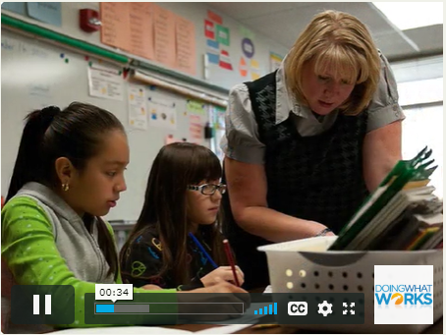
#2B: Strategy in Action
https://raisingthebar.wested.org/resource/interactive-strategies-teaching-nonfiction-text-structure
Notes:
Say: Let’s watch a third/fourth-grade teacher and the instructional activities she uses to help her students understand the compare-contrast and sequence nonfiction text structures. She uses cooperative learning strategies, graphic organizers, and games. The video is 4 min and 22 sec.

Slide 46
#2B: Optional Resource
https://www.youtube.com/watch?v=d_ZL0yEeUac
Notes:
Say: There are a series of YouTube videos based on research supported by the Institute of Education Sciences, through a grant to Texas A & M University. These are one optional resource that can be used to provide teachers with the why and hows of text structure.
(If time allows, show some or all of the videos based on the participants’ needs).

Slide 47
2 Potential Roadblocks for Recommendation #2
Roadblock 1: Teachers may not have time to analyze texts to determine how they are structured and how learning that structure contributes to students’ reading comprehension.
Roadblock 2: Students can apply text structure knowledge in classroom assignments but may not do so independently or with more complex texts.
Notes:
Say: There are a number of roadblocks for recommendation #2.
Roadblock 1: Teachers may not have time to analyze texts to determine how they are structured and how learning that structure contributes to students’ reading comprehension.
Teachers should use common lesson-planning time to collaborate on developing lists of texts that offer clear examples of particular structures and structural elements as well as clue words. Through this kind of collaboration, teachers can teach students about structure through a broader range of texts than if they were working alone, and the knowledge can be spread across many teachers and used in subsequent years. The school library may also have trade books for teachers that identify texts that are good choices to teach particular elements.
Roadblock 2: Students can apply text structure knowledge in classroom assignments but may not do so independently or with more complex texts.
Teachers should encourage students to pay attention to text structure across a wide variety of reading experiences. Students who can use text structure successfully during a reading lesson may forget to do so when reading a social studies book or reading on their own. It can help to provide a quick reminder of the value of structure just as such reading is about to begin. Also, teachers should encourage students to bring them any texts whose structure they cannot figure out. Teachers could use such opportunities to clarify structure and help students to resolve problems with more complex texts.

Slide 48
2 Possible Roadblock Solutions
Make or identify book lists that are examples of specific text structures and provide students reminders of the value of recognizing text structure when they begin to read.
Encourage students to bring them any texts whose structure they cannot figure out.
Notes:
(Participants should follow the directions for the handout Comprehension Recommendations and Possible Solutions and mark any possible solution that may work for their school/classroom for this recommendation).
Say: For roadblock solutions, teachers who do not have books that are examples of particular text structures, have them use common lesson-planning time to collaborate on developing lists of texts that offer clear examples of particular structures and structural elements as well as clue words. Through this kind of collaboration, teachers can teach students about structure through a broader range of texts than if they were working alone, and the knowledge can be spread across many teachers and used in subsequent years. The school library may also have trade books for teachers that identify texts that are good choices to teach particular elements.
(click)
Teachers should encourage students to pay attention to text structure across a wide variety of reading experiences. Students who can use text structure successfully during a reading lesson may forget to do so when reading a social studies book or reading on their own. It can help to provide a quick reminder of the value of structure just as such reading is about to begin.
(click)
Also, teachers should encourage students to bring them any texts whose structure they cannot figure out. Teachers could use such opportunities to clarify structure and help students to resolve problems with more complex texts.
(

Slide 49
Recommendation #3 A
#3: Guide students through focused, high-quality discussion on the meaning of text.
Structure the discussion to complement the text, the instructional purpose, and the readers’ ability and grade level.
Develop discussion questions that require students to think deeply about text.
Ask follow-up questions to encourage and facilitate discussion.
Have students lead structured small-group discussions.
Notes:
Say: Let’s look at recommendation #3. The panel recommends that teachers lead their students through focused, high-quality discussions in order to help them develop a deeper understanding of what they read. Such discussions among students or between the students and the teacher go beyond simply asking and answering surface-level questions to a more thoughtful exploration of the text. Through this type of exploration, students learn how to argue for or against points raised in the discussion, resolve ambiguities in the text, and draw conclusions or inferences about the text. The panel believes that students in kindergarten through 3rd grade are capable of having this kind of a discussion if they have appropriate guidance from their teacher.
(click)
Teachers should consider how the type and content of the text will affect the discussion they plan to hold. The text used will affect the goals of a discussion, the extent to which students are interested in the discussion, and the questions teachers use to stimulate discussion. A text is more likely to prompt a rich discussion if it features either a character who faces a conflict or a real-world problem that presents a dilemma, because both give students an opportunity to support one side of an issue or the other.
For younger students: Read aloud and ask students periodically about what’s happening, what the story is about, or what they think is going to happen.
Facilitate a discussion by using a variety of higher-level questions that prompt the students to interpret the text.

Slide 50
#3A: Locate and Recall (Standards #1-#3)
Standards 1 - 3
Notes:
Say: Discussions and questions should be grounded in our standards. The National Assessment of Educational Progress (NAEP) standards, includes three categories of comprehension. Our standards coordinate with these.
(Click) Grade Level Standards #1 - #3 address students asking and answering questions about key details and the main idea. Teacher and students should ask questions about what the text means, what the main idea is, and which details support that idea.
Before the discussion, the teacher might prepare a guide for the class that highlights which questions students should ask and which the teacher should ask. Teachers should ask some questions and moderate the discussion, but students should do most of the talking
Adapting for younger students: Locate and Recall
• Take a greater role by asking more questions when working with younger students.
• Explicitly model how to think about the question. For example, the teacher could say: “The question asks about what koalas eat. I am going to look for a heading that talks about food or eating. Headings are these larger, boldface words that tell us what a part of the text is about. Here’s a heading that says ‘Food for Koalas.’ I am going to read that section. I think it will tell me what koalas eat.”

Slide 51
#3A: Integrate and interpret (Standards #4-#6)
Standards 4 - 6
Notes:
Say: In discussion, the teacher begins by reminding students of the comprehension strategies they already know. The teacher then asks the students to read a small portion of the text themselves. When they are finished, the teacher leads a discussion about what they just read, and so on throughout the entire text. The questions asked by the teacher should lead the students to summarize what happens in the text and to interpret these events in light of their own experience, knowledge, or other parts of the text.
(click)
These questions can target grade level standards #4 - #6 of the reading standards.
Adapting for younger students : Integrate and Interpret
• Read aloud and ask students periodically about what’s happening, what the story is about, or what they think is going to happen.
• Facilitate a discussion by using a variety of higher-level questions that prompt the students to interpret the text.

Slide 52
#3A: Critique and Evaluate (Standards #7-#9)
Standards 7 - 9
Notes:
Say: In discussion, the teacher assigns a text that poses a dilemma about which students might disagree, such as the appropriateness of a particular character’s actions or whether the outcome of a story seems realistic.
Divide students into teams according to the opinions they express after they read (listen) to the text. Each team is asked to pick out parts of the text that support its opinion .To facilitate this process, the teacher could distribute sticky notes to students and ask them to mark these points in the text. Students could also mark text that they think is confusing, and teachers could use this material as the basis of a class discussion about what information is needed to make the text easier to understand.
(click) These questions can target grade level standards #4 - #6 of the reading standards.
Adapting for younger students: Critique and Evaluate
Read a selection aloud, and have students discuss it with a partner and then report back to the class. To start a discussion at that point, the teacher can ask students whether they think the character did the right thing.

Slide 53
Notes:
Say:
This graph provides us with on overall view of how we are helping our students engage with text through well designed text dependent questions. On the left of the graphic we note how much of a text we may be attacking through specific types of questions. On the right side of the graphic we can determine which standards we are attacking. In the middle of the graphic we note what skills we are attacking through specific standards. (This graphic is included in the guidance document provided at the beginning of the presentation).

Slide 54
#3A: Questioning Strategy in Action
https://raisingthebar.wested.org/resource/teaching-early-readers-questioning-strategies
Notes:
Say: Lets watch how a first-grade teacher uses interactive puppets and cooperative learning strategies like think-pair-share to teach her students about questioning. (This video is 4 min & 18 seconds).

Slide 55
Recommendation #3 B
#3: Guide students through focused, high-quality discussion on the meaning of text.
Structure the discussion to complement the text, the instructional purpose, and the readers’ ability and grade level.
Develop discussion questions that require students to think deeply about text.
Ask follow-up questions to encourage and facilitate discussion.
Have students lead structured small-group discussions.
Notes:
Say:
Teachers should develop higher-order questions that encourage students to think deeply about what the text means rather than simply recalling details.

Slide 56
#3B: Considerations
Considerations:
the best time to present each question to students;
which questions should be asked when students first read the text;
which questions should be asked after a second or subsequent reading.
Notes:
Say: Questions should reflect what teachers want students to draw from the text, including implicit as well as explicit information. They generally should not be simplistic (“What is the boy’s name?”) or ask just for an opinion (“Did you like the story?”). Typical higher-order questions include
Why did _______?
What do you think _______ ?
If you were the author _______?
What does ______ remind you of and why?
When preparing questions, teachers should think about the following:
the best time to present each question to students—before, during, or after reading;
which questions should be asked when students first read the text;
and which questions should be asked after a second or subsequent reading.
In a similar vein, teachers should determine exactly where in the text a question will be asked (e.g., after a specific page, paragraph, or illustration). For students in kindergarten and 1st grade, shared reading time or read-alouds provide an opportunity to introduce higher-order questions that invite discussion.

Slide 57
#3B: Sample of Close Reading Questions
First Reading: Determine what the text says.
• What is the text about? • What is the theme of the story? • What was _____ (character) like, and what did he/she do in the story?
Second Reading: Figure out how the text works
• What does _____ (a word from the text) mean in this context? • Who is telling this part of the story? • What is the author’s purpose for this section?
Third Reading: Analyze and compare the text
• What information do these illustrations add to the text? Or, how does this picture differ from what the author wrote? • Compare _____ (an aspect of the text, such as character or main idea) with the same aspect in another text by the same author. (Readers can also examine texts on the same topic or from the same genre.) • What reasons does the author give to support _____ (one of the ideas)?
(Shanahan, https://www.scholastic.com/teachers/articles/teaching-content/common-core-close-reading-0/
Notes:
Say: Timothy Shanahan, distinguished professor emeritus at the University of Illinois at Chicago provides some insights on the place close reading and the questions that should be asked in article from Scholastic. He reminds us that not every text deserves a close read. Sometimes it’s okay to be interested only in the story—considerations of craft and structure and deeper implications are beside the point. And classroom reads don’t always have to emphasize close reading; the key is to incorporate close reading into your instruction, not use it exclusively. No one knows how many teacher-led close reads would be a good idea, but don’t overdo it; one or two close reads every couple of weeks (some taking place over multiple days) seems like the right dosage. The questions on this slide provide insight on how questions should be built and when they should be asked.
The handout titled Questioning for Greater Comprehension
offers additional information from Dr. Shanahan.

Slide 58
Recommendation #3 C
#3: Guide students through focused, high-quality discussion on the meaning of text.
Structure the discussion to complement the text, the instructional purpose, and the readers’ ability and grade level.
Develop discussion questions that require students to think deeply about text.
Ask follow-up questions to encourage and facilitate discussion.
Have students lead structured small-group discussions.
Notes:
Say:
Next, we want to emphasize the importance of follow-up questions. Reading comprehension improves when teachers ask follow-up questions that encourage students to apply the reading comprehension strategies they know.
Additional information for presenter:
The questions should be asked in the context of a curriculum in which students are taught comprehension strategies as described in Recommendation 1. In a sustained discussion, teachers should respond to the students’ answers in a way that leads them to think about and elaborate on their answers and the meaning of the text.
Teachers should ask students to refer to the text to justify their answers. Depending on the grade level, this may mean recalling events and passages in the text or pointing to illustrations to justify their answers. Follow-up questions should both provide students with a model for thinking about the text and its meaning more actively, and help them learn to construct and support opinions with textual evidence. Examples of recommended follow-up questions include the following

Slide 59
#3C Classroom Discussion Using Follow-Up Questions
What makes you say that?
What happened in the book that makes you think that?
Can you explain what you meant when you said _______?
Do you agree with what _______ said? Why or why not?
How does what you said connect with what _______ already said?
Let’s see if what we read provides us with any information that can resolve _______ ’s and ________ ’s disagreement.
What does the author say about that?
Notes:
Say: Ideally, initial questions and follow-up questions should resemble a collaborative discussion instead of a typical cycle of teacher initiation (teacher asks a question), student response (one student answers the question), teacher evaluation (teacher evaluates the student’s response), followed by the teacher asking an unrelated question directed at the class or a different student. Although common in classrooms, this kind of discourse does not allow students to build meaning from the text in a collaborative way. For younger students, the panel believes that follow-up questions can facilitate discussion, particularly when teachers conduct the discussion in small groups with appropriate supports such as clarifying student answers and guiding students to respond to one another’s answers positively.
Students new to in-depth discussion may struggle with this format. Therefore, teachers should model the format and guide them in responding to the text while keeping them focused on both meaning and the discussion question at hand. Younger students may require additional assistance in answering some of these kinds of questions. Throughout the discussion, teachers should remind students to talk to one another and not just to the teacher.

Slide 60
Recommendation #3 D
#3: Guide students through focused, high-quality discussion on the meaning of text.
Structure the discussion to complement the text, the instructional purpose, and the readers’ ability and grade level.
Develop discussion questions that require students to think deeply about text.
Ask follow-up questions to encourage and facilitate discussion.
Have students lead structured small-group discussions.
Notes:
Say:
As students become more proficient in discussion, the panel suggests providing opportunities for peer-led discussions about text in which students pose questions to their peers.
The key to forming groups is to include students who are relatively good at discussion in each group and to allow students to direct the discussion.
Small-group discussions for younger students will be shorter and more structured than discussions for older students; the questions will also require more follow-up questions.

Slide 61
#3D: Optional Resource
Notes:
Say: An optional resource for teachers to use when implementing this recommendation is to view is the handout “Have Students Lead Structured Small-Group Discussions”. If time allows, jigsaw the article or provide time for participants to read it and share out key findings.

Slide 62
4 Potential Roadblocks for Recommendation #3
Roadblock 1: When students are talking with peers, some teachers believe they do not have control of the classroom discussion.
Roadblock 2: Students do not understand how to conduct productive discussions about the text with one another.
Roadblock 3: It is difficult to find time to prepare for classroom discussions.
Roadblock 4: It is difficult to find time to devote to discussion when also teaching decoding skills, comprehension strategies, and vocabulary.
Notes:
Say: There are potential roadblocks for this recommendation.
Roadblock 1: When students are talking with peers, some teachers believe they do not have control of the classroom discussion.
Though discussion involves teachers giving up some control, there are things that can be done to ensure that students stay on task during a discussion. For instance, teachers should provide a clear set of guidelines for discussing the text, including the structure of the discussion and the use of discussion guides, and model higher-order questions and responses to help students stay on point. These supports can serve as “training wheels” while the students strengthen their ability to take part in this kind of a discussion. Teachers can monitor how well students are staying on task from outside the group and can offer assistance as necessary.
Roadblock 2: Students do not understand how to conduct productive discussions about the text with one another.
Teachers should give students opportunities to observe and practice discussion techniques; what is expected of them as discussion leaders should be clearly outlined. Teachers can prepare students to lead a discussion by modeling a leader’s behavior and techniques, and then gradually releasing this responsibility to the students. Teachers may consider setting aside a time at the beginning of the year to focus on discussion skills. They may also want to keep peer discussions relatively brief at first, giving students enough time to develop the ability to lead longer discussions. For younger students, who may struggle the most with the group nature of discussions, the panel suggests having them turn and talk to their neighbors.
Roadblock 3: It is difficult to find time to prepare for classroom discussions.
To capitalize on limited time, the panel recommends that teachers collaborate with one another, taking turns preparing discussion questions and guides. Teachers should also establish regular times for discussion early in the school year. In schools where there is only one teacher per grade, teachers can plan collaboratively with teachers at other schools using email or online, and cross-age discussions can be valuable as well. The more practice students have with discussion, the less time teachers will need to spend teaching the activity. Finally, fully developed discussion guidelines can be used repeatedly, saving preparation time.
Roadblock 4: It is difficult to find time to devote to discussion when also teaching decoding skills, comprehension strategies, and vocabulary.
Finding enough time to teach everything there is to teach is a challenge, especially in schools that serve a diverse student population. That said, high-quality discussions should be part of the school day because they have a great deal to do with improving reading comprehension. Devoting time only to word-level skills will not be sufficient to help primary grade students become effective readers. Students developing decoding skills and fluency also need to develop their knowledge of the world and their ability to think about what they read. This can be accomplished in time-efficient ways. For instance, instead of handling discussion as a stand-alone task, teachers can make it part of the process of teaching other comprehension strategies. In addition, teachers can make the most of the time devoted to guiding students through a high-quality discussion by thoroughly preparing for the discussion.

Slide 63
4 Possible Roadblock Solutions
Provide a clear set of guidelines for discussing the text, including the structure of the discussion and the use of discussion guides, and model higher-order questions and responses to help students stay on point.
Model a student’s behavior and techniques, and then gradually releasing this responsibility.
Teachers should collaborate with one another, taking turns preparing discussion questions and guides.
Make it part of the process of teaching other comprehension strategies.
Notes:
(Participants should follow the directions for the handout Comprehension Recommendations and Possible Solutions and mark any possible solution that may work for their school/classroom for this recommendation).
Say: There are possible solutions for potential roadblocks. They include the following: click and animate
Roadblock 1. When students are talking with peers, some teachers believe they do not have control of the classroom discussion.
(click) Suggested Approach. Though discussion involves teachers giving up some control, there are things that can be done to ensure that students stay on task during a discussion. For instance, teachers should provide a clear set of guidelines for discussing the text, including the structure of the discussion and the use of discussion guides, and model higher-order questions and responses to help students stay on point.⁸⁷ These supports can serve as “training wheels” while the students strengthen their ability to take part in this kind of a discussion. Teachers can monitor how well students are staying on task from outside the group and can offer assistance as necessary.
Roadblock 2. Students do not understand how to conduct productive discussions about the text with one another.
(click) Suggested Approach. Teachers should give students opportunities to observe and practice discussion techniques; what is expected of them as discussion leaders should be clearly outlined. Teachers can prepare students to lead a discussion by modeling a leader’s behavior and techniques, and then gradually releasing this responsibility to the students. Teachers may consider setting aside a time at the beginning of the year to focus on discussion skills. They may also want to keep peer discussions relatively brief at first, giving students enough time to develop the ability to lead longer discussions. For younger students, who may struggle the most with the group nature of discussions, the panel suggests having them turn and talk to their neighbors.
Roadblock 3. It is difficult to find time to prepare for classroom discussions.
(click) Suggested Approach. To capitalize on limited time, the panel recommends that teachers collaborate with one another, taking turns preparing discussion questions and guides. Teachers should also establish regular times for discussion early in the school year. In schools where there is only one teacher per grade, teachers can plan collaboratively with teachers at other schools using email or online, and cross-age discussions can be valuable as well. The more practice students have with discussion, the less time teachers will need to spend teaching the activity. Finally, fully developed discussion guidelines can be used repeatedly, saving preparation time.
Roadblock 4. It is difficult to find time to devote to discussion when also teaching decoding skills, comprehension strategies, and vocabulary.
(click) Suggested Approach. Finding enough time to teach everything there is to teach is a challenge, especially in schools that serve a diverse student population. That said, high-quality discussions should be part of the school day because they have a great deal to do with improving reading comprehension. Devoting time only to word-level skills will not be sufficient to help primary grade students become effective readers. Students developing decoding skills and fluency also need to develop their knowledge of the world and their ability to think about what they read. This can be accomplished in time-efficient ways. For instance, instead of handling discussion as a stand-alone task, teachers can make it part of the process of teaching other comprehension strategies. In addition, teachers can make the most of the time devoted to guiding students through a high-quality discussion by thoroughly preparing for the discussion.

Slide 64
Recommendation #4
#4: Select texts purposefully to support comprehension development.
Teach reading comprehension with multiple genres of texts.
Choose texts of high-quality with richness and depth of ideas and information.
Choose texts with word recognition and comprehension difficulty appropriate for the students’ reading ability and the instructional activity.
Use texts that support the purpose of instruction.
Notes:
Say: Recommendation #4 addresses the selection of texts. (click) It is important that teachers have a variety of genres of texts available to teach comprehension development.

Slide 65
4A: Multiple Genres
Use both literary and informational texts to teach reading comprehension instruction, because a student’s mastery of one does not necessarily transfer to the other.
Notes:
Say: Teachers should use both literary and informational texts to teach reading comprehension instruction, because a student’s mastery of one does not necessarily transfer to the other. (Digital texts may be literary or informational, and the panel believes that students should learn to read and comprehend them. )
Additional information for presenter:
The NAEP Reading Framework divides texts into the two broad types of literary and informational.
Literary texts include fiction, literary nonfiction, and poetry; in the elementary grades, literary texts can include historical fiction, fables, and autobiographies.
Informational texts include expository writing, pieces that argue in favor of one position or another, and procedural texts and documents. In the elementary grades, informational texts can include such texts as news articles, speeches, and timelines.

Slide 66
Recommendation #4 and Instructional Practices
#4: Select texts purposefully to support comprehension development.
Teach reading comprehension with multiple genres of texts.
Choose texts of high-quality with richness and depth of ideas and information.
Choose texts with word recognition and comprehension difficulty appropriate for the students’ reading ability and the instructional activity.
Use texts that support the purpose of instruction.
Notes:
Say: (click) Also, as educators, we should make sure the texts we choose are high quality with richness and depth.

Slide 67
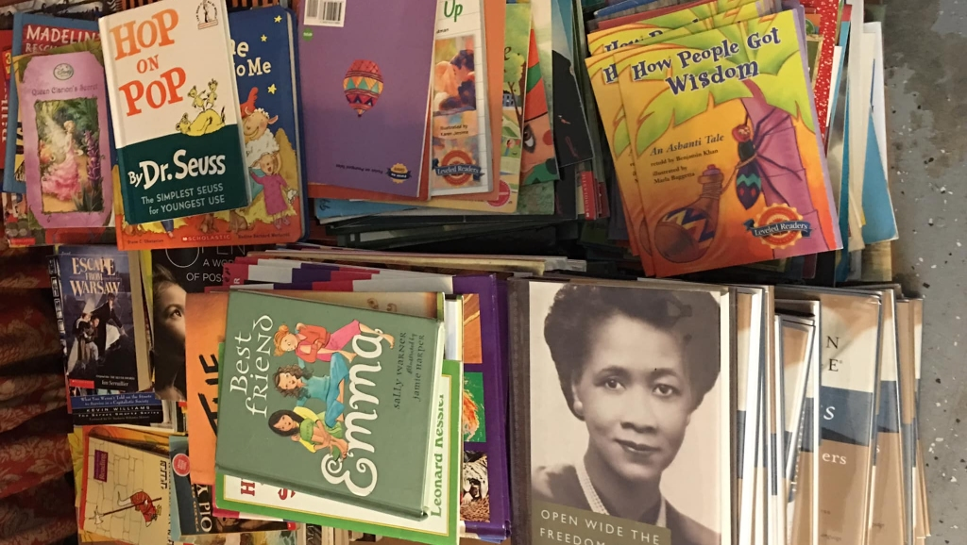
#4B: Text Selection
Rich in depth of ideas and information
Difficulty matches with the students’ word-reading and comprehension skills
Supports the purpose of the lesson
Notes:
Say: There is no such thing as “one-size-fits-all” when it comes to selecting a text for teaching reading comprehension. The panel believes that early exposure to different types of text builds the capacity to understand the large variety of reading material that students will encounter as they move from grade to grade. Not only should teachers introduce students to a variety of texts, but teachers should also ensure that a selected text
(click) (1) is rich in depth of ideas and information,
(click) (2) has a level of difficulty commensurate with the students’ word-reading and comprehension skills, and (click) (3) supports the purpose of the lesson.
Specifically for younger students, the panel believes that all texts require students to make inferences or check their understanding, and students’ comprehension could always be enhanced by retelling elements of the text.

Slide 68
#4B: Sample Nonfiction Picture Books
Recent nonfiction texts reveal an
Emphasis on the visual
Emphasis on accuracy
Engaging writing style
Notes:
Say: Children's nonfiction picture books is a genre that is exploding in both quality and quantity. Recent nonfiction books reveal an (click) emphasis on the visual, an (click) emphasis on accuracy, and an (click) engaging writing style. For example, you might share out with your students the following:
(click) "Hey, kids! Did you know that in the 1930s most Americans did not own TVs? But you know what they did have? The radio!" So begins the text of Aliens Are Coming! The True Account of the 1938 War of the Worlds Radio Broadcast (McCarthy, 2006).”
In these few words, author and illustrator Meghan McCarthy invites young readers into the book by using a reader-friendly tone, asking a question to make the reading interactive, and helping readers make connections between their experiences with television and the way people in the 1930s experienced radio. Even before they begin to read the text, however, children are attracted to this book by the cover, end papers, and title page. Illustrated in cartoon style, the cover features two green aliens with eyes on stalks and octopus-like appendages. The title is done in a childlike font, and the word Coming looks like it is written in oozing green goo. The endpapers show cartoon spaceships and flying saucers, while on the title page a cartoon alien points toward the earth. The title, with its exclamation point and colorful block letters, is reminiscent of an old-time movie poster. Together these features give the book a light-hearted tone and invite children inside. Written with only a few lines per page, the book tells the story of Orson Welles's famous radio broadcast that caused widespread fear and panic. Illustrations in black and white depict scenes of the 1930s, while bright colors are used to show how people imagined the scenes being described on the radio. Excerpts from the text of the radio broadcast help readers understand the impact of the broadcast on radio listeners. Detailed endnotes give more information about the story of the broadcast and include a sidebar about H.G. Wells and a bibliography.
Aliens Are Coming! is just one of many recent nonfiction books that have features that attract young readers, help them learn about a topic, and invite further thinking and exploration.

Slide 69
#4B: Sample Nonfiction Picture Books
Notes:
Say: Drawing students attention to other text structures are helpful. Other examples include:
In Sled Dogs (Haskins, 2006), two-page spreads provide information in the form of large and small captioned photographs, sidebars, and text. Design elements such as the black background, blue frames around photographs and other features, and even the blue shape around the page number, contribute to a whole that is visually pleasing.
In another well-designed book, Why Do Dogs Have Wet Noses? (Coren, 2006), each page has a subtle background print with a dog-bone pattern, a border of dog bones across the top, and a dog bone over the page number at the bottom of the page. Photographs of varying sizes, some in frames and other with text wrapping around them, help break up the text, as do the headings written in a playful, uneven typeface. The same typeface is used on the cover, which features a photograph of a cute puppy with his head tilted inquisitively.
Stunning, high-quality, glossy photographs by wildlife photographers dominate the book Slippery, Slimy Baby Frogs (Markle, 2006b), providing information in visual form that is as important as the information in the text.
Nic Bishop's Spiders (2007) combines beautiful photographs, colorful backgrounds, and typefaces that change in size and color to emphasize important or interesting points.
A unique and creative approach to illustration can be found in What Athletes Are Made Of (Piven, 2006), in which portraits of famous athletes are composed of simple painted shapes and everyday objects chosen to convey something about the athlete. Muhammad Ali's portrait, for example, includes a bell for a nose and tiny microphones for eyebrows. A hot dog on a bun makes Babe Ruth's mouth, golf tees make up Tiger Woods's eyebrows, and Michael Jordan's tongue is a piece of basketball skin!

Slide 70
Recommendation #4 and Instructional Practices
#4: Select texts purposefully to support comprehension development.
Teach reading comprehension with multiple genres of texts.
Choose texts of high-quality with richness and depth of ideas and information.
Choose texts with word recognition and comprehension difficulty appropriate for the students’ reading ability and the instructional activity.
Use texts that support the purpose of instruction.
Notes:
Say: Key to meeting the needs of all learners is choosing texts with word recognition and difficulty appropriate for students’ reading ability and instructional activity.

Slide 71
#4C: Appropriate for Instruction
Two Aspects to Text Difficulty
Textual/linguistic Demands: Decodability of the words Complexity of the sentences Text organization | Content Demands: How complex, abstract or subtle the information is
Text Complexity
Notes:
Say: Teachers should select text that is neither too simple nor too difficult for students. There are at least two aspects to text difficulty: textual/linguistic demands (e.g., decodability of the words, complexity of the sentences and text organization, clarity of the formatting), and content demands (i.e., how complex, abstract, or subtle the information is).
When our ELA standards were adopted in 2010, we were introduced to the term (click) text complexity which encompasses the factors on the slide and in the panel’s research.

Slide 72
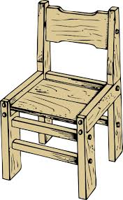
#4C: “Just Right” Books for Independent Reading
Notes:
Say: Choosing a “just right” book is a phrase that educators use to encourage students to choose a book that is not too hard, not too easy, but just right for the child’s reading level. The more just right books a child reads, the better reader he or she will become. Think of the story of Goldilocks and the Three Bears. Goldilocks chooses the (click) porridge, (click) chair, and (click) bed just right for her.
The same process takes place when choosing books (without the bears coming home at the end!). It is important that students learn the process of choosing a book that is just right for them, because as they grow and learn their just right books will change.

Slide 73
Recommendation #4 and Instructional Practices
#4: Select texts purposefully to support comprehension development.
Teach reading comprehension with multiple genres of texts.
Choose texts of high-quality with richness and depth of ideas and information.
Choose texts with word recognition and comprehension difficulty appropriate for the students’ reading ability and the instructional activity.
Use texts that support the purpose of instruction.
Notes:
Say: Finally, our texts should support our purpose for instruction.

Slide 74
#4D. Purpose Driven Texts
Giving a lesson on text structure
Introducing students to a strategy
Building a student’s depth of understanding
Teaching students to make predictions
Reading with students
Reading to students
Notes:
Say: Given the large variety of possible goals, the panel believes these points are important for teachers to consider when selecting texts to support the instructional purpose.
When the teacher is
(click) Giving a lesson on text structure • Begin with a text about a familiar topic in which the structure is easy to identify. Move to a text on a less familiar topic and with a somewhat more complex structure.
(click) Introducing students to a strategy (such as summarizing) • Select a text where the strategy is easily applied. Once students have had time to practice, select a more challenging text.
(click) Building a student’s depth of understanding  Avoid texts that only reinforce a student’s knowledge of sound-letter relationships. These types of texts are more suitable for practicing decoding and word recognition.
(click) Teaching students to make predictions  Select a text that is unfamiliar to them, or one in which many outcomes are possible.
(click) Reading with students (such as with a big book or digitally projected text)  Select a text that is just above the students’ reading level.
(click) Reading to students (such as a read-aloud)  Select a text that is well above the students’ reading level but is at their listening comprehension level.

Slide 75
3 Potential Roadblocks for Recommendation #4
Some school systems have a set curriculum or program in place, and teachers may have little choice in the texts used for teaching comprehension.
The range of word-reading and comprehension levels in the classroom makes it difficult to select appropriate texts.
There are a lot of texts available to choose from, which makes it hard to know where to start.
Notes:
Say: There are at least 3 potential roadblocks for recommendation #4. They include:
Some school systems have a set curriculum or program in place, and teachers may have little choice in the texts used for teaching comprehension.
The range of word-reading and comprehension levels in the classroom makes it difficult to select appropriate texts.
There are a lot of texts available to choose from, which makes it hard to know where to start.

Slide 76
3 Possible Roadblock Solutions
Use science and/or social science texts to teaching reading comprehension in addition to literature.
Provide different texts to different students depending on the student and on the teacher’s instructional needs.
Build a library of texts that reflect student and classroom needs.
Notes:
(Participants should follow the directions for the Comprehension Recommendations and Possible Solutions handout and mark any possible solution that may work for their school/classroom for this recommendation).
Say:
Some school systems have a set curriculum or program in place, and teachers may have little choice in the texts used for teaching comprehension. A solution may be able to use district science or social studies materials to teach reading comprehension. Teachers could also look to other sources for appropriate books (a school or public library, a local literacy council, or a book drive). Teachers should discuss their concerns about appropriate texts with their administrators.
Secondly, the range of word-reading and comprehension levels in the classroom makes it difficult to select appropriate texts. It is a good idea for teachers to provide different texts to different students depending on the student and on the teacher’s instructional goals. Teachers can also place students in groups according to their interests or the reading lesson. If there is content that all students need to learn, a selection of texts that address the same content at different levels of complexity can be used. Teachers can consult knowledgeable colleagues and, when they are available, literacy coaches and lead teachers who are familiar with children’s texts that suit particular demands and address particular topics.
Over time, finding the appropriate text may become less of a challenge as teachers build their personal “library” of texts that suit different instructional goals and purposes. For suggestions, teachers can consult administrators and other colleagues, including literacy coaches and lead teachers who are familiar with texts for a particular grade level.

Slide 77
Recommendation #5 and Instructional Practices
#5: Establish an engaging and motivating context in which to teach reading comprehension.
Help students discover the purpose and benefits of reading.
Create opportunities for students to see themselves as successful readers.
Give students reading choices.
Give students the opportunity to learn by collaborating with their peers.
Notes:
Say:
Students must actively engage with text to extract and construct its meaning, and they will become better readers if they are taught reading comprehension in an engaging, motivating context. A teacher can create this context by clearly conveying the purpose of each lesson, explaining to students how the comprehension strategies will help them learn, and impressing on them that the power to be successful readers rests as much with them as it does with their teacher. We will begin this recommendation with A. (Click) “Help students discover the purpose an benefits of reading.”

Slide 78
#5A: Purpose for Reading
Notes:
Say: When walking students to the cafeteria, a teacher might stop to read the students a memo posted on a bulletin board that notifies teachers of a meeting. The teacher would then say: “Oh! There is a meeting for teachers after school today. It’s a good thing I stopped to read this note so that I can be sure to attend.” Teachers could use this scenario to later encourage students to brainstorm about similar situations in which people read about something and how this helps them.

Slide 79
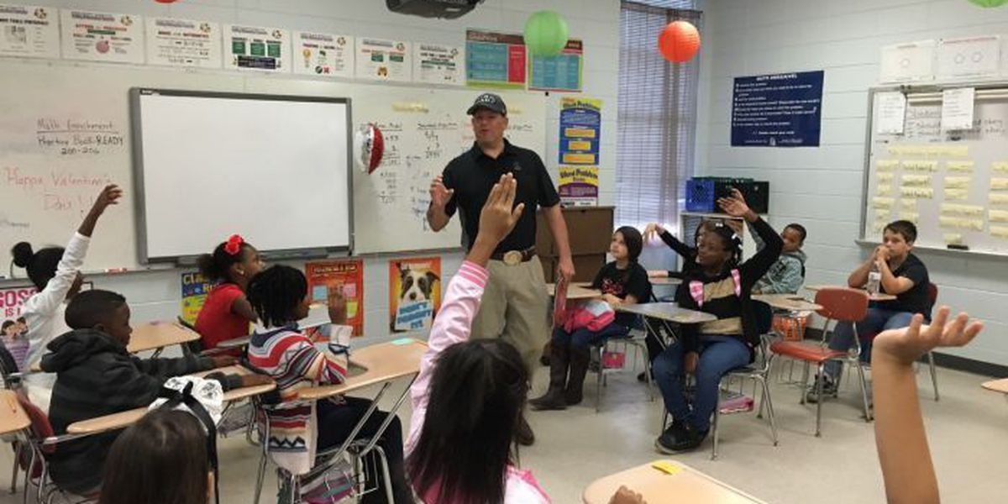
Optional Idea: Host a Reading Fair
Host a Reading Fair
Notes:
Say: Teachers should model how the ability to read affects our daily life, provides enjoyment, and helps students learn about the world. One idea is for teachers to host a Reading Fair. Invite family and community members to bring in the types of reading they do “on the job” emphasizing how important it is to be a good reader. Have them also bring some of their favorite texts they read for enjoyment. Don’t forget to invite other school educators and even some high school students to share the reading that they do.

Slide 80
Recommendation #5 and Instructional Practices
#5: Establish an engaging and motivating context in which to teach reading comprehension.
Help students discover the purpose and benefits of reading.
Create opportunities for students to see themselves as successful readers.
Give students reading choices.
Give students the opportunity to learn by collaborating with their peers.
Notes:
Say: Create opportunities for students to see themselves as successful readers.

Slide 81
Provide Attainable Challenge
Notes:
Say: Many times we neglect to talk about the power of meeting a challenge. Walking up a hill is challenging, but attainable. If you ask someone to walk on flat ground, it offers no challenge. If you ask someone to climb a cliff, it is too challenging and giving up is a likely result. Reading comprehension activities should be challenging but attainable with effort, so that students learn to appreciate rather than fear challenge. Teachers should set the bar high but clearly express their expectations that students meet the comprehension challenges in front of them. Instead of punishing students for mistakes or failures, it is better to help them to recognize and learn from such errors; remember, the point is learning.
Let students know that mistakes or difficult tasks are opportunities to learn, and encourage them to try despite the challenges.
Teachers should pay careful attention to the difficulty of reading assignments and to support students as they are learning to read.

Slide 82
Notes:
Say: To support students, especially those that have difficulty with reading independently and comprehending, is to break the text into sections and have students take time and use strategies to process chunks of the text. For students who are not reading, this applies to listening comprehension as well.
(Keep in mind that stronger readers may not need or want the text to be broken into chunks.)

Slide 83
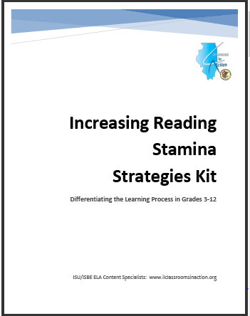
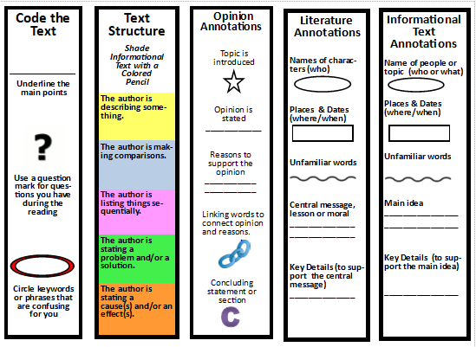
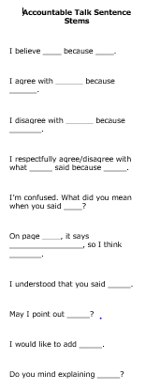
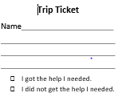
Optional Tool: Increasing Reading Stamina Strategies Kit
http://www.ilclassroomsinaction.org/reading-on-grade-level.html
Notes:
Say: When students do complete challenging tasks or acquire new skills, provide frequent and specific praise. Working with them to set goals, monitoring their progress toward those goals, and providing frequent positive feedback on their performance can boost students’ confidence, which the panel believes increases students’ intrinsic motivation to read. One potential tool for teachers is the “increasing Reading Stamina and Strategies Kit.” It will provide additional ideas and supports for teachers when working with students who need structures in place to continue to grow as readers. (The link on the slide will show the location of the kit).

Slide 84
Productive Struggle: Fostering a Growth Mindset
 | Instructional Strategies
Questioning | Asking the right questions Asking questions at the right time
Encouraging | Teachers encouraging students to participate in reflective practice
Time Allowance | Allow students the time needed to manage the struggle
Acknowledging | Teacher acknowledging that struggling with anything helps the student grow
Notes:
Say: Keep in mind that instructional strategies alone are not enough. If our students are to meet the standards, we must foster the growth mindset that will help them see struggle as a natural part of learning, not as a lack of intelligence.
We must remove the stigma from struggle in our literacy classrooms and give our students more opportunities to struggle productively with complex text. The 4 components of fostering a growth mindset with reading could include the strategies on this slide.
For additional information:
https://www.teachermagazine.com.au/articles/learner-persistence-the-productive-struggle

Slide 85
Recommendation #5 and Instructional Practices
#5: Establish an engaging and motivating context in which to teach reading comprehension.
Help students discover the purpose and benefits of reading.
Create opportunities for students to see themselves as successful readers.
Give students reading choices.
Give students the opportunity to learn by collaborating with their peers.
Notes:
Say: (click) The next instructional practice is “Give students reading choices.”

Slide 86
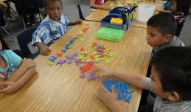
#3C: Reading Choices
Allow students to choose from a variety of reading activities or centers.
Permit students to choose the order in which they complete their work.
Encourage students to think of questions that lead them to texts that will hold their interest.
Notes:
Say: Reading choices should be in line with the teacher’s instructional purpose. The panel encourages teachers to think creatively about how to give their students a choice in what they read. For example, teachers can
• (click) Allow students to choose from a variety of reading activities or centers.¹²⁶ Students could go to their classroom literacy center and choose to read to themselves, to a friend or stuffed animal, or to a tape recorder that would later be reviewed by the teacher.
• (click)Permit students to choose the order in which they complete their work. When flexibility is possible, teachers can allow students to decide which center to visit or which text to read first within a set time frame.
• (click) Encourage students to think of questions that lead them to texts that will hold their interest.¹²⁸ Teachers can support students in finding topics that interest them during reading activities. For example, one student might be interested in the weather, and the teacher may guide him or her toward asking, “Where does thunder come from?” and then direct the student to a text that could answer his or her question.
Adapting for younger students
Provide limited and specific choices. This can help them learn how to make choices and stay on task.

Slide 87
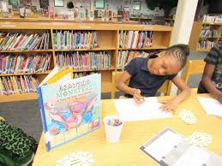
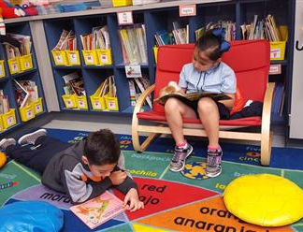
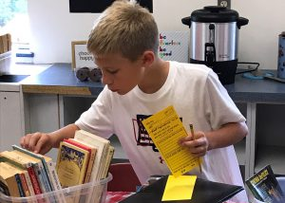
Allow students to choose how to respond to a text.
Give students a choice in where they can read.
Allow students to choose from a selection of texts that serve an instructional purpose.
Notes:
Say:
Allow students to choose how to respond to a text. Students might present what they learned from their book to the class, work in a group to dramatize a story, keep a journal about the text, or compose an alternative ending to a story for others to read.
• Give students a choice in where they can read. Some students might be more comfortable reading at their desks or in a secluded corner of the classroom where they are better able to concentrate. For others, a comfortable chair or carpeted area with pillows might be more inviting.
• Allow students to choose from a selection of texts that serve an instructional purpose. For example, to teach about the similarities and differences between animals, teachers might allow students to choose from various texts about animals and ask them to report on what they learned to the group. Students can also take turns selecting a text for the teacher to read aloud to the class from a limited range of options appropriate to the lesson.

Slide 88
Recommendation #5 and Instructional Practices
#5: Establish an engaging and motivating context in which to teach reading comprehension.
Help students discover the purpose and benefits of reading.
Create opportunities for students to see themselves as successful readers.
Give students reading choices.
Give students the opportunity to learn by collaborating with their peers.
Notes:
Say: (click) The next instructional practice is “Give students the opportunity to learn by collaborating with their peers.”

Slide 89
#5D: Collaborating with Peers
Conditions:
When students perceive their roles as valuable
When teachers motivate students to help their peers learn rather than simply giving their peers the answer
Notes:
Say: Collaborative learning opportunities, whether simple or elaborate, should allow all the students in the group to work together to complete the task. The panel believes that collaborative learning activities are most productive under two conditions: (1) when the students perceive their roles as valuable and (2) when teachers motivate students to help their peers learn rather than simply giving their peers the answer.

Slide 90
Notes:
Say: Ask students to read the same text and then talk to a partner about what they read, what they predicted, and any connections they made while reading.

Slide 91
Notes:
Say:
Pair a student who wants to read a book that is too difficult with a higher-performing reader. Both students can read aloud, alternating paragraphs or pages. As the higher-performing student practices reading fluently, he or she is also modeling fluent reading to the other student. Teachers should guide students in providing constructive support to their peers.

Slide 92
Notes:
Say: Pair students to retell a story, identify the main characters or story setting, or make predictions about how the story will end
Adapting for younger students
Teachers can provide props such as cutouts or puppets and model how the students will use the puppets to retell the story.

Slide 93
Notes:
Say:
Pair or group students to learn interesting facts from informational texts. Students can take turns sharing their favorite fact from the same text. Teachers can provide guidance about where students can look for interesting facts.

Slide 94
Notes:
Say:
Group students to use how-to texts to perform a simple task. Students can take turns following the instructions step-by-step to complete the task as a group. Model strategies for the students to use when reading how-to texts.

Slide 95
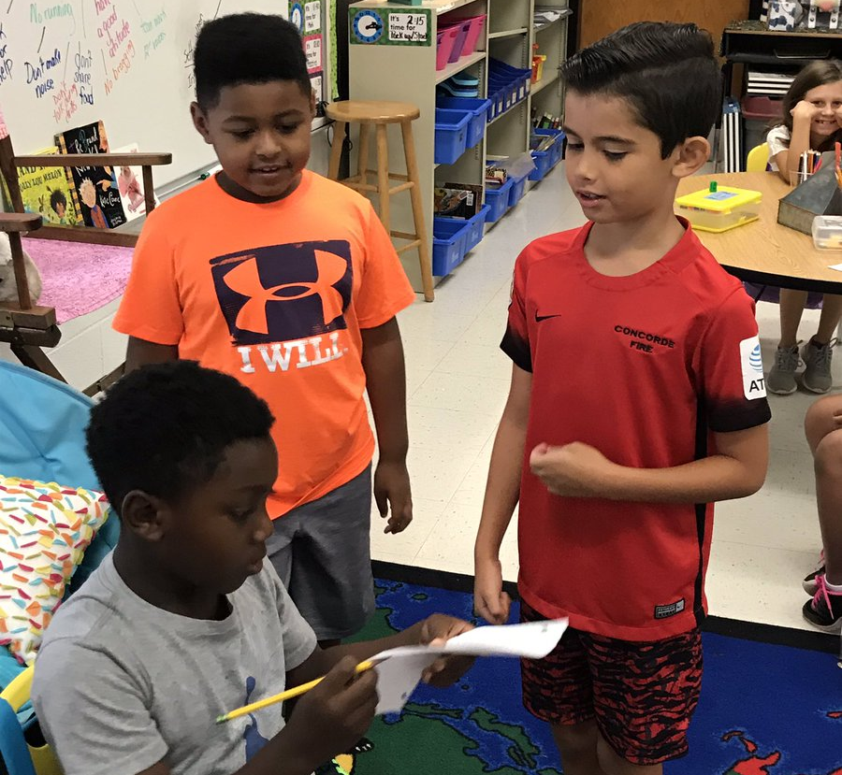
Notes:
Say:
Group students to perform a scripted version of a story they have read, create their own dramatization of a story, or write a new story.
Encourage students to support and motivate one another as they do challenging reading comprehension activities.

Slide 96
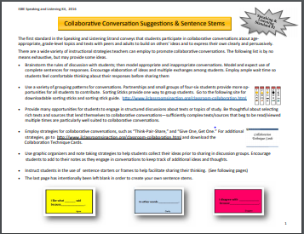
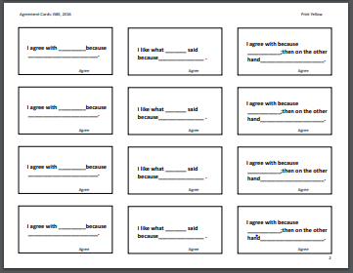
#5D: Optional Tool: Sentence Stems
I have a question about _______________.
I disagree with _____________ because__________.
I like what _______ said because________.
http://www.illinoisliteracyinaction.org/uploads/4/0/7/1/40712613/6_collaborative_conversation_sentence_stems_jb.pdf
Notes:
Say: One resource for instructing students in having quality discussions about what they are reading is in the use of sentence starters or frames to help facilitate sharing student thinking. (These sentence stems are included in the Increasing Reading Stamina and Strategies Kit and can be found at the link at the bottom of the slide.)

Slide 97
4 Potential Roadblocks for Recommendation #5
Roadblock 1: When students are in learning groups, they may get off task.
Roadblock 2: Some students may not engage in classroom reading comprehension activities.
Roadblock 3: Teachers may not have the resources to offer the range of choices that may appeal to students.
Roadblock 4: Some students may choose texts that are too easy or too difficult for them.
.
Notes:
Say: Let’s read through 4 potential roadblocks.

Slide 98
Possible Roadblock Solutions
Be careful to not give up too much control all at once.
Consider providing additional motivational supports for students who are not engaged in reading.
Offer choices that do not involve expense. (i.e., read to a partner/stuffed animal)
Offer small groups, browsing boxes and selection tips.
Notes:
(Look at the Comprehension Recommendations and Possible Solutions handout – follow directions as you move through the slides).
Say:
One suggestion for roadblock #1 (When students are in learning groups, they get off task) is that teachers should make sure that students understand the activity’s purpose and explain it again if they do not. Teachers should also be careful not to give up too much control all at once. For instance, the teacher should sit just outside the group to monitor it closely and intervene if students stray from the task. As the students learn to collaborate, teachers may reduce their monitoring. Finally, teachers can give one student in each group the responsibility for politely reminding everyone to stay on task.
A suggestion for roadblock 2 (Some students still will not engage in classroom reading comprehension activities) is for teachers to consider providing additional motivational supports for students who are not engaged in reading, such as developing special projects involving reading. Teachers should offer positive feedback and should be mindful that aversion to reading may signal frustration, boredom, or possibly a learning disability. Teachers might consider asking a colleague to observe their classroom and brainstorm about how to reach particularly disengaged students
With roadblock 3, teachers may not have the resources to offer the range of choices that may appeal to students, or they may believe that content standards do not allow them to offer such choices.
Teachers could offer students choices that are appealing but not elaborate or costly. For instance, teachers can allow students to read with a partner to practice fluency, to read aloud to a stuffed animal, or to read quietly to themselves. Teachers who have access to the Internet can make use of resources created by other teachers. If the concern is about content standards, a teacher can follow up a lesson—on a particular strategy or text, for example—by allowing students to read a text they choose on their own, or choose other activities, such as reading to a peer.
With Roadblock 4, (students often choose texts that are too easy or too difficult for them), teachers can group students by reading level and offer them a selection of books that match that level. Teachers can also create individual “browsing boxes,” which contain texts that are expected to be at an appropriate level for each student. Teachers can also teach students explicitly how to select appropriate titles. The “five finger method” is a good example. A student chooses one text and begins to read it, holding all five fingers up. For each word that gives him trouble, he folds down a finger. If he folds down all five fingers while reading the same page, he must look for an easier book.

Slide 99
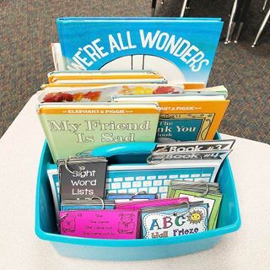
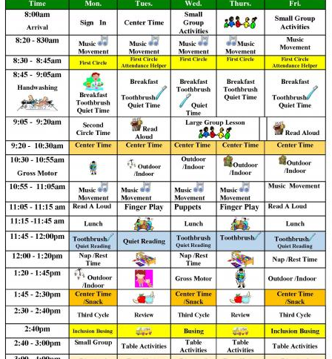
Instruction, Materials and Time Matters
Notes:
Say: After seeing what research says about reading comprehension, let’s take time to look at our instruction, materials and assessments to see if what happens in the classroom is moving our students towards reading on grade level.

Slide 100
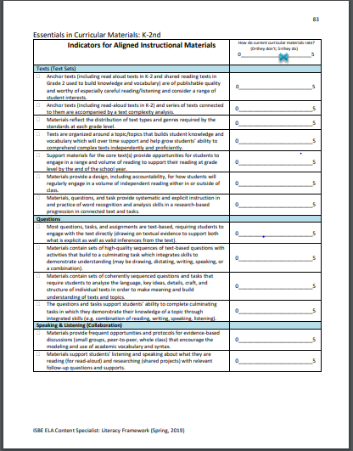
Materials Matter
Let’s examine the indicators that coordinate with this module:
Texts
Questions
Speaking & Listening
Writing
Notes:
Say Teachers deserve access to high-quality, aligned instructional materials to support their classrooms.” Located in your guidance document is a checklist that we will use to quickly assess how the materials that we use align to the standards. The checklist is derived from Ed Reports Review Tool and provides a comprehensive list of materials needed to meet the standards. We are going to pause and take time to do a quick assessment of our current materials. While our recommendations do not address all that we are looking at, it will give us an overview of what our literacy materials should address collectively.
Pause Point: After looking over the list, have participants share out what they note may be lacking or missing from their materials.

Slide 101
Materials Matter
Ed Reports: www.edreports.org
Click on Compare Materials
Choose Grade Band (K-2 or 3-5)
Notes:
Say: EdReports.org is an independent nonprofit designed to improve K-12 education. This website contains reviews of instructional materials to determine standards alignment in order to equip teachers with excellent materials nationwide. Check and see if Ed Reports has reviewed your materials. If so, the report will provide teachers details about the alignment of the materials they use.
Additional Information: Feel free to take them through the site and look at reviews.
.

Slide 102
Time Matters
Notes:
Say: Instruction matters, materials matter and of course, time matters - especially for our struggling readers. Students who struggle need more opportunities to engage with skills they struggle with. Research shows that the choice of an appropriate literacy curriculum is extremely high-stakes, because a poor selection may undermine many students’ achievement … therefore, the choice must be a well-informed one” that is subsequently implemented with fidelity.
Such a curriculum would ideally be evidence-based with clear indications for how teachers should allocate their time. (Spear-Swerling & Zibulsky, 2014)

Slide 103
Assessment
Assessments should mirror the instruction.
Notes:
Say: Assessments should mirror the instruction students receive. How close do your assessments mirror the what students are learning and more importantly, is your program/instruction offering students what they need?

Slide 104
Assessment
Notes:
Say: Now let’s address assessment. Reading Rockets has provided an informal assessment chart. Let’s take a look and identify the informal assessments that can assess comprehension. (Hand out the “Overview of Informal Reading Assessments: from Reading Rockets)
Allow participants time to scan the document and then share with the whole group the assessment(s) that can be used to assess comprehension. Participants can share out other assessments they use in their classroom to assess this standard.

Slide 105
Next Steps
Based on the information from Module 5: Reading Comprehension, what “next steps” might be needed for your classroom?
Notes:
Say: Using the “Module 5: Improving Reading Comprehension” handout and the “Comprehension Recommendations & Possible Solutions” handout used in the presentation, determine the next steps you and/or your school would like to take. Participants can share with a partner and then share out. Say: Who would like to share?

Slide 106
Resources
Notes:
Say: Now that we have examined important components of comprehension, let’s explore some resources that may be beneficial when addressing comprehension in our classrooms.

Slide 107
School to Home Resources
Reading Rockets Adventure Packs for Families
https://www.readingrockets.org/article/reading-adventure-packs-families
Notes:
Say: Reading Rockets has developed a set of reading adventure packs to encourage hands-on fun and learning centered around paired fiction and nonfiction books. The pack includes a paired set of theme books and related interactive activities that kids bring home from school to share with their family.
The link on the slide will take you to the home page for the Adventure Packs.

Slide 108
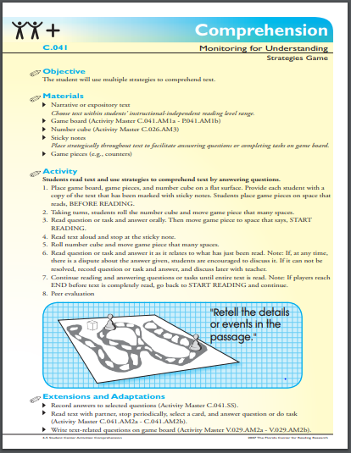
Resources
Student Center Activities
https://www.fcrr.org/curriculum/SCA_CCSS_index.shtm
Notes:
Say: The Florida Center for Reading Research offers a plethora of easy to make games that can be used at school or sent home for practice in areas students still need to refine or learn. The link on the slide will take participants to the website to search for activities.

Slide 109
Educator Resources
Notes:
Say: This book s a plethora of information concerning struggling readers. Teaching Struggling Readers: How to Use Brain Research to Maximize Learning by Carol A. Lyons offers insight into how the brain works and impacts learning.

Slide 110
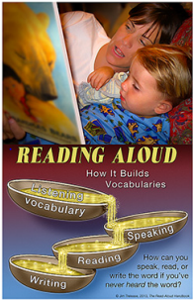
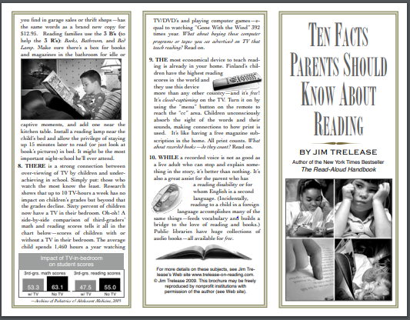
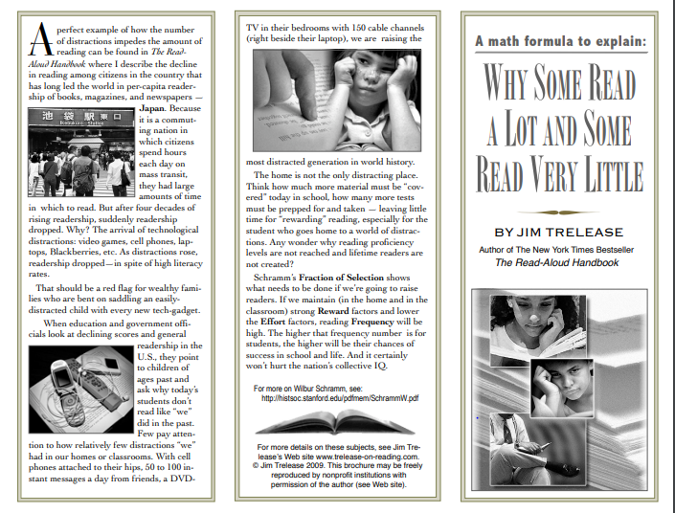
Educator Resource
Jim Trelease Website
http://www.trelease-on-reading.com/brochures.html
Notes:
Say: The Jim Trelease website has a lot to offer schools and classrooms and are helpful to share with parents. (If time permits, allow teachers to explore.)
To access these brochures, schools/teachers must first, email Jim Trelease and seek permission to print the brochures, include in your correspondence the name and address of the requesting organization, if its nonprofit status, and how it will be used.
If available, hand out some examples of brochures.

Slide 111
Educator Resource
Illinois Literacy in Action Website
www.illinoisliteracyinaction.org
Notes:
Say: A plethora of resources, including this module, can be found at illinoisliteracyinaction.org. This link will take you to the illinoisliteracyinaction.org page. From here you can access all modules.

Slide 112
References
Shanahan, T. (2013). Differentiating for Text Difficulty Under Common Core. In Shanahan on Literacy. Retrieved April 15, 2013, from http://www.shanahanonliteracy.com/2013/02/differentiating-for-text-difficulty.html?m=1
Fisher, D., & Frey, N. (2012, November). Close Reading In Elementary Schools. The Reading Teacher, 66(3), 179-188.
Shanahan, T., Callison, K., Carriere, C., Duke, N. K., Pearson, P. D., Schatschneider, C., & Torgesen, J. (2010). Improving reading comprehension in kindergarten through 3rd grade: IES practice guide. NCEE 2010-4038. What Works Clearinghouse: Princeton, NJ.
Notes:
This slide provides references used.

